Slide 1
Do Now
Answer these questions in your workbook.
Does increasing the temperature of your milk, make the milo dissolve faster? 1. What is the independent variable?
2. What is the dependent variable.
3. Name 3 control variables you would need to consider if you were to test this.
4. Write a hypothesis you could test if you did this experiment.
Temperature of the milk
Time for milo to dissolve
Amount of milk, amount of milo, stirring or no stirring, room temperature
If we increase/decrease the temperature of the milk, then the milo will dissolve faster /slower

Slide 2
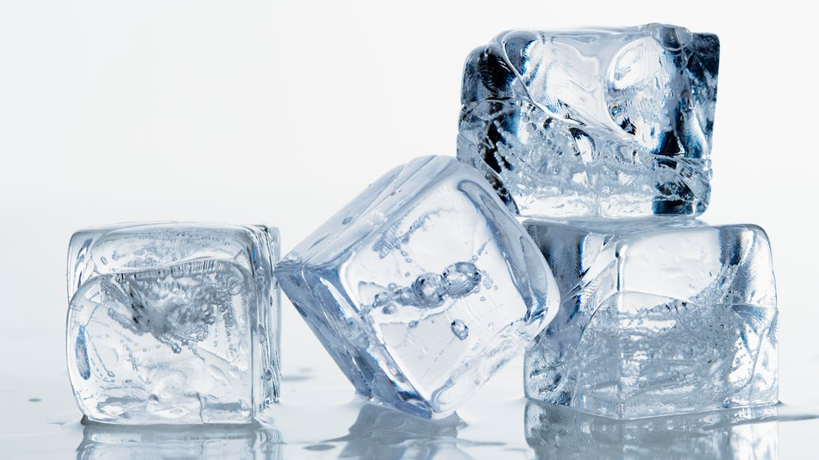
Daily Review
Properties of Matter
The states of matter can be described using three properties:
Shape: whether it holds its own shape or changes to fit the container
Solids have a fixed (unchanging) shape, liquids and gases do not
Volume: the amount of space it takes up
Solids and liquids have a fixed (unchanging) volume, gases do not
Compressibility: whether it can be made smaller by applying a force
Solids and liquids cannot be compressed, gases can
What state is ice? Explain your decision using the terms volume, shape and compressible.

Slide 3
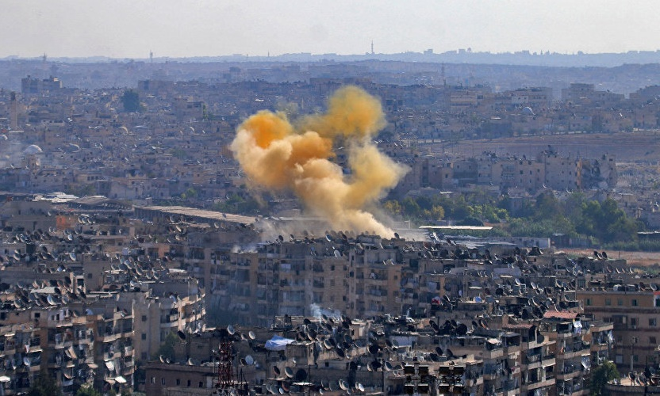
Daily Review
Properties of Matter
The states of matter can be described using three properties:
Shape: whether it holds its own shape or changes to fit the container
Solids have a fixed (unchanging) shape, liquids and gases do not
Volume: the amount of space it takes up
Solids and liquids have a fixed (unchanging) volume, gases do not
Compressibility: whether it can be made smaller by applying a force
Solids and liquids cannot be compressed, gases can
What state is chlorine gas? Explain your decision using the terms volume, shape and compressible.

Slide 4
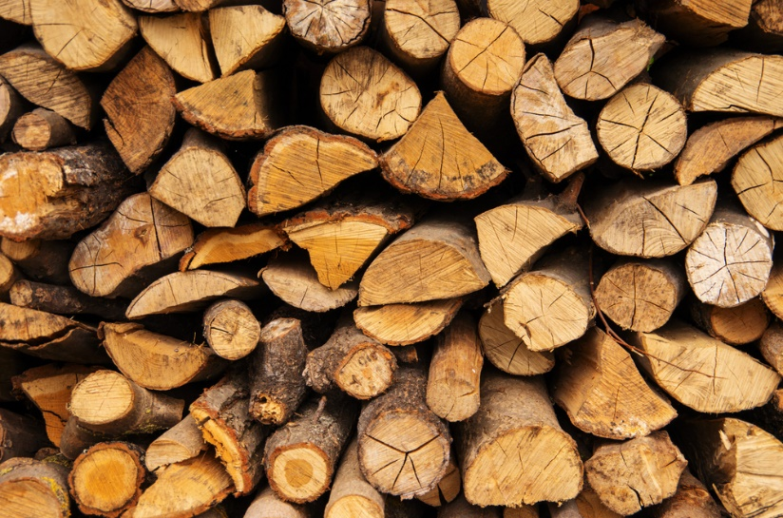
Daily Review
Properties of Matter
The states of matter can be described using three properties:
Shape: whether it holds its own shape or changes to fit the container
Solids have a fixed (unchanging) shape, liquids and gases do not
Volume: the amount of space it takes up
Solids and liquids have a fixed (unchanging) volume, gases do not
Compressibility: whether it can be made smaller by applying a force
Solids and liquids cannot be compressed, gases can
What state is wood? Explain your decision using the terms volume, shape and compressible.

Slide 5
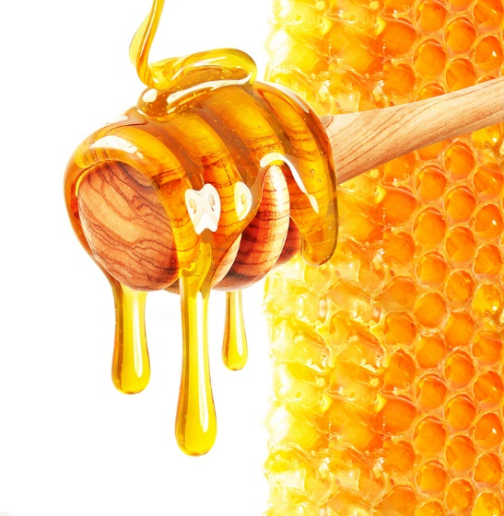
Daily Review
Properties of Matter
The states of matter can be described using three properties:
Shape: whether it holds its own shape or changes to fit the container
Solids have a fixed (unchanging) shape, liquids and gases do not
Volume: the amount of space it takes up
Solids and liquids have a fixed (unchanging) volume, gases do not
Compressibility: whether it can be made smaller by applying a force
Solids and liquids cannot be compressed, gases can
What state is honey? Explain your decision using the terms volume, shape and compressible.

Slide 6
The Kinetic Theory of Matter Year 8 Science

Slide 7
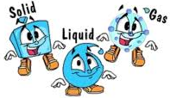
Learning Objective
CFU
What are we going to learn?
List the four main ideas of the kinetic theory of matter.
Use the kinetic theory to describe the properties of each state of matter.
Activate Prior Knowledge
What happens when you put two liquids together?
Does the same thing happen when you put two solids together? Why not?
Vocabulary
describe (verb) to give characteristics and features

Slide 8
Concept Development
CFU 1
Can you see the particles that matter is made of?
Kinetic theory of matter: explains why solids, liquids and gases behave the way they do.
All matter:
1. Made of a huge number of tiny particles
2. There is nothing between the particles.
3. The particles are always moving.
4. As temperature increases, the particles move more (their kinetic energy increases).
CFU 2
What is in between the particles?
CFU 3
True or False: solid particles stay still, but liquid and gas particles are constantly moving.
CFU 4
What happens to particles as they heat up?
Vocabulary
theory (noun) a collection of ideas that explains something | particle (noun) a very small amount of matter

Slide 9
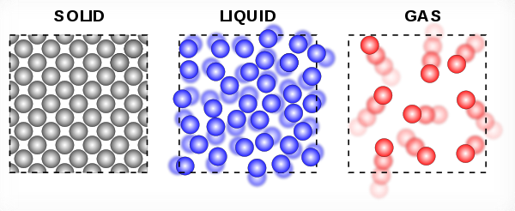
Concept Development
CFU 1
How much kinetic energy do solids have compared to other states?
Solid particles have the smallest amount of kinetic (movement) energy, so:
they are held closely together in a regular (consistent) pattern
they only vibrate – they do not move around other particles
CFU 2
How are solids arranged?
CFU 3
Describe how solid particles move.

Slide 10
Concept Development
CFU 1
How much kinetic energy do liquids have compared to other states?
Liquid particles have a medium amount of kinetic (movement) energy, so:
they are packed closely together in a random way
they can move around each other and other particles (e.g. solids)
CFU 2
How are liquids arranged?
CFU 3
Describe how liquid particles move.
Vocabulary
particle (noun) a very small amount of matter

Slide 11
Concept Development
CFU 1
How much kinetic energy do gases have compared to other states?
Gas particles have a huge amount of kinetic (movement) energy, so:
they are spaced far apart in a random way
they are constantly moving at high speeds
CFU 2
How are gases arranged?
CFU 3
Describe how gas particles move.
Vocabulary
particle (noun) a very small amount of matter

Slide 12
Skill Development / Guided Practice
CFU 1
Which properties of matter have we learnt about?
We have learnt about three properties of each state of matter:
Volume
Shape
Compressibility
These properties can be explained by:
The arrangement of particles
The movement of particles
CFU 2
What can we use to explain the properties of each state?

Slide 13
Skill Development / Guided Practice
CFU 1
How are these particles arranged?
Solids:
held closely together in a regular (consistent) pattern
only vibrate – they do not move around other particles
Liquids:
packed closely together in a random way
can move around each other and other particles
Gases:
spaced far apart in a random way
constantly moving at high speeds
CFU 2
How do these particles move?
CFU 3
Which of these features explains the property?
Example:
Can a solid be compressed? Why or why not?
A solid cannot be compressed because the particles are already held closely together in a regular pattern.
Vocabulary
compressed (verb) made smaller by applying pressure

Slide 14
Skill Development / Guided Practice
CFU 1
How are these particles arranged?
Solids:
held closely together in a regular (consistent) pattern
only vibrate – they do not move around other particles
Liquids:
packed closely together in a random way
can move around each other and other particles
Gases:
spaced far apart in a random way
constantly moving at high speeds
CFU 2
How do these particles move?
CFU 3
Which of these features explains the property?
Example:
Can a gas be compressed? Why or why not?
A gas can be compressed because the particles have a lot of space between them. This allows the particles to be pushed together.
Vocabulary
compressed (verb) made smaller by applying pressure

Slide 15
Skill Development / Guided Practice
CFU 1
How are these particles arranged?
Solids:
held closely together in a regular (consistent) pattern
only vibrate – they do not move around other particles
Liquids:
packed closely together in a random way
can move around each other and other particles
Gases:
spaced far apart in a random way
constantly moving at high speeds
CFU 2
How do these particles move?
CFU 3
Which of these features explains the property?
Why does a liquid have no fixed shape?
A liquid has no fixed shape because the particles can move around each other.
Vocabulary
fixed (adjective) held securely in place

Slide 16
Skill Development / Guided Practice
CFU 1
How are these particles arranged?
Solids:
held closely together in a regular (consistent) pattern
only vibrate – they do not move around other particles
Liquids:
packed closely together in a random way
can move around each other and other particles
Gases:
spaced far apart in a random way
constantly moving at high speeds
CFU 2
How do these particles move?
CFU 3
Which of these features explains the property?
Why does a gas have no fixed shape?
A gas has no fixed shape because the particles are spaced far apart and randomly arranged. The particles are also constantly moving in all directions.
Vocabulary
fixed (adjective) held securely in place

Slide 17
Relevance
Knowing the properties of matter can help you predict how a substance will behave.
The kinetic theory helps explain how matter in different states interacts.
Reminder
Solids: held closely together in a regular (consistent) pattern only vibrate – they do not move around other particles Liquids: packed closely together in a random way can move around each other and other particles
Skill Closure
Why does a solid have a fixed shape?
Why can a liquid not be compressed?

Slide 18
Independent Practice
Complete this table with your partner in your book or on your device. You may need more than one line for each explanation.
State | Properties | Kinetic Theory Explanation
Solid | Cannot compress Fixed shape Fixed volume
Liquid | Cannot compress No fixed shape Fixed volume
Gas | Can compress No fixed shape No fixed volume

